Slide 1
Data Cleaning, Part II
CS3300 Data Science
RJ Nowling

Slide 2
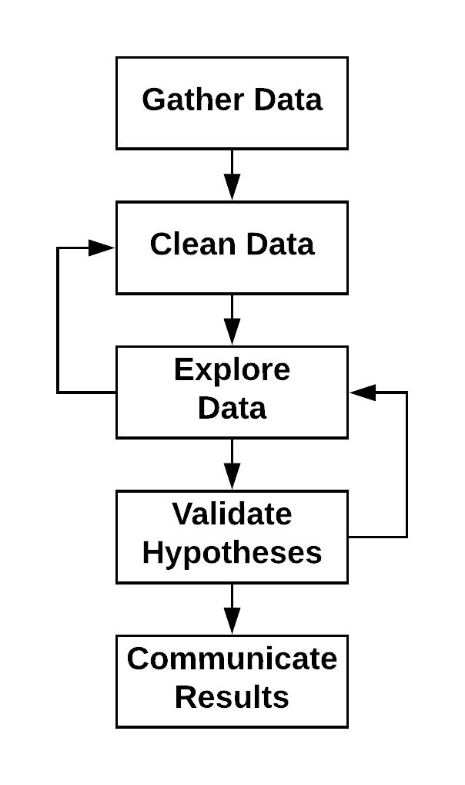
Data Science Process
Application of the scientific method to data
Data Science vs Machine Learning
Data Science: Understand the data and its Relationships better. Uses machine learning to explore data and validate those relationships
Machine Learning: Goal is to build a predictive model. Data Science is used to identify variables for the models and evaluate the models by creating an experimental framework

Slide 3
Data Cleaning Steps
Parse the file format to read in the data. At the end of this stage, for each record, you should be able to separate the values belonging to each field
Convert data to consistent representations (e.g., spelling of state names, format of dates)
Convert values to the right types (e.g., floats, datetimes, categorical)
Convert values to the right units (e.g., everything in inches)
Remove outlier records

Slide 4
Unification

Slide 5
Data Representation Unification
Data of the same type might not be stored in a consistent format
A common example are dates and times. Dates follow a number of patterns:
YYYY-MM-DD
MM-DD-YY
We need to convert these to a single representation before we can parse them
We call this unification

Slide 6
Data Representation Unification
Another example are state names:
Mississippi
MS
Miss.
People can easily misspell or use different abbreviations for state names
We call this name unification

Slide 7
Handling Varying Data Representations
Your goal is to convert every representation to a single, canonical representation for each piece of information (e.g., single state name)
For example, with dates, you would need to write a custom function to guess the date format for each String and parse it to produce a DateTime object accordingly
In many cases, the various representations do not belong to a standard so you need to use a guess-and-check approach
Look at the data by eye!

Slide 8
Example: Parsing Date and Times
def parse_date(date_string):
"""
Parse datetimes like
'Tue, 10 Apr 2007 19:25:38 +0000'
'Fri, 18 May 2007 12:15:02 -0700 (PDT)'
'14 May 2007 04:27:55 +0000'
'2007-06-02 17:35:21'
"""
if date_string is None:
return None
# remove trailing "(GMT)"
if date_string.endswith(")"):
idx = date_string.rfind(" ")
date_string = date_string[:idx]
# remove preceding day of the week
if "," in date_string:
idx = date_string.find(",") + 2
date_string = date_string[idx:]
# remove timezone offset
idx = date_string.rfind(" ")
date_string = date_string[:idx]
try:
fmt = "%d %b %Y %H:%M:%S"
return dt.datetime.strptime(date_string, fmt)
except:
try:
fmt = "%Y-%m-%d %H:%M:%S"
return dt.datetime.strptime(date_string, fmt)
except:
return None

Slide 9
Exercise: State Names
How would you handle different state names (e.g., misspellings)?

Slide 10
Choosing the Right Types
Text (String)
Numerical
Integer (int32, int64)
Float (float32, float64)
Boolean (bool)
Categorical
Date / Times
timedelta64[ns]
datetime64[ns]
Timestamp

Slide 11
Choosing the Right Types
Pandas tries to infer the data types when using load_csv() or similar
Is it is likely that Pandas will guess incorrectly at times
You can change types using astype(): df["at_bats"] = df["at_bats"].astype(np.float32) df["state"] = df["state_names"].astype("category")

Slide 12
Should It Be Categorical?
Some data sets encoded categorical data as integers
1 – Red
2 – Green
3 – Blue
This data is mis-encoded. Integers imply an ordering. Categories do not have orderings.
Similarly, Strings are not usable for plots, statistical tests, or machine learning.
If the values of a String field contains many duplicated values (e.g., state names), it should probably be categorical.

Slide 13
Text Data
If String data is complex (e.g., street addresses, email bodies, or comments), it cannot be used directly
Variables can be extracted from text
For example, given addresses like "1234 Madison St.", we can extract:
Home numbers
Street names
Street types (street, court, way, etc.)

Slide 14
Unit Conversions
All of the values in a single field should be in the same unit (e.g., inches, dollars)
Date times and currencies are usually the most common problems:
Times may be in different time zones. Time zones are very complicated (based on geography, time of year)
International data will use different currencies. Currency exchange rates vary in time.

Slide 15
Bad or Missing Values

Slide 16
Errors vs Artifacts
Fields can contain bad values:
Dates outside of expected ranges (e.g., in the future)
NaNs
Missing values
We can classify causes into two categories:
Errors
Artifacts

Slide 17
Errors vs Artifacts
Errors
Artifacts
Information fundamentally lost in acquisition
E.g., Missing logs because a server crashed
Information cannot be recovered
Systematic problems arising from processing
e.g., bad date formats
Cannot be corrected so long as the original data is still available

Slide 18
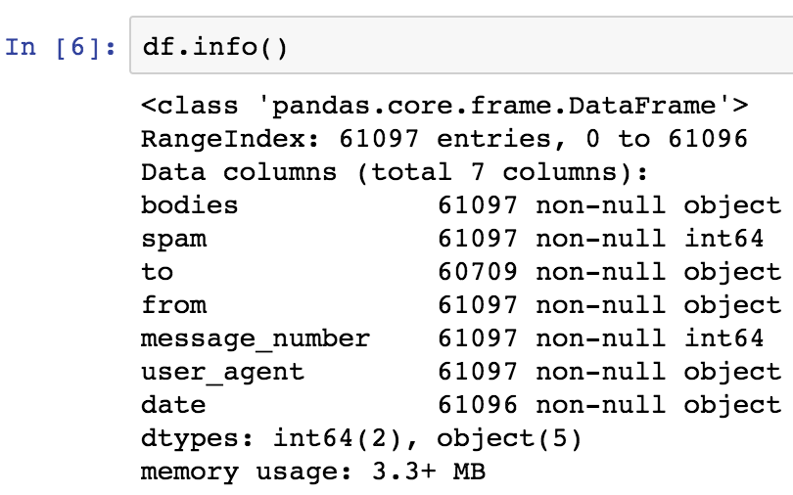
Missing Values
Fields may contain missing values
Statistical and machine learning methods do not work with nulls
We can check for missing values (represented as nulls):

Slide 19
Missing Values: Meaningful
Missing values have multiple causes
Missing value has a structural meaning:
"Prior activity" field in glucose notebook. Missing value means no prior activity was performed.
Survey questions. A survey may have a question that should only be answered if a previous question was answered.
These missing values should be instead represented by a placeholder categorical value ("no activity", "not applicable")

Slide 20
Missing Values: Data Cleaning Errors
Missing values may be present because of badly-formatted data
Data cleaning processes are often "guess and check"
Fail on edge cases and needs to be updated
To keep the data cleaning process from crashing, bad values are skipped and replaced with nulls
Need to fix the data cleaning process and re-process the data

Slide 21
Missing Values: Just Missing
In the third case, missing values are just missing
e.g., server crashed and logs are lost for a period of time
Remove records with missing values across many fields
Impute the values
Replace the missing values with an estimated value
Need to think carefully about which imputation strategies make sense

Slide 22
Imputation: Mean or Mode
A simple imputation strategy
Calculate the mean, median, or mode of known values
Replace missing values with calculated value
Tends to be safe in that imputed values will not bias ML models
Most common practice
May not be appropriate:
e.g., using an average birth year for for historical figures

Slide 23
Imputation: Nearest Neighbor
More complex strategy
Find similar records using other fields with known values
Use known values from similar records to impute missing value
Not many good (robust) implementations available
May fail when a large number of records have missing values
Complex
Requires transforming data (feature engineering, scaling) to work well
Basically doing machine learning at that point

Slide 24
When to Impute
When in the data science process should you impute?
Many resources describe imputation during the exploratory data analysis process; I disagree
The goal of many analyses is to use data we have to make predictions about data we haven't seen yet
Imputing missing values using all data will violate our experimental setup (train / test split) for machine learning
Better to impute using the training set
EDA is generally concerned with one or two variables at a time – easier to just ignore missing values in those columns when making plots
Most plotting libraries ignoring missing values by default

